Slide 1

Kuhn Tucker (KT) conditions
optimality conditions for a constrained local optimum

Slide 2
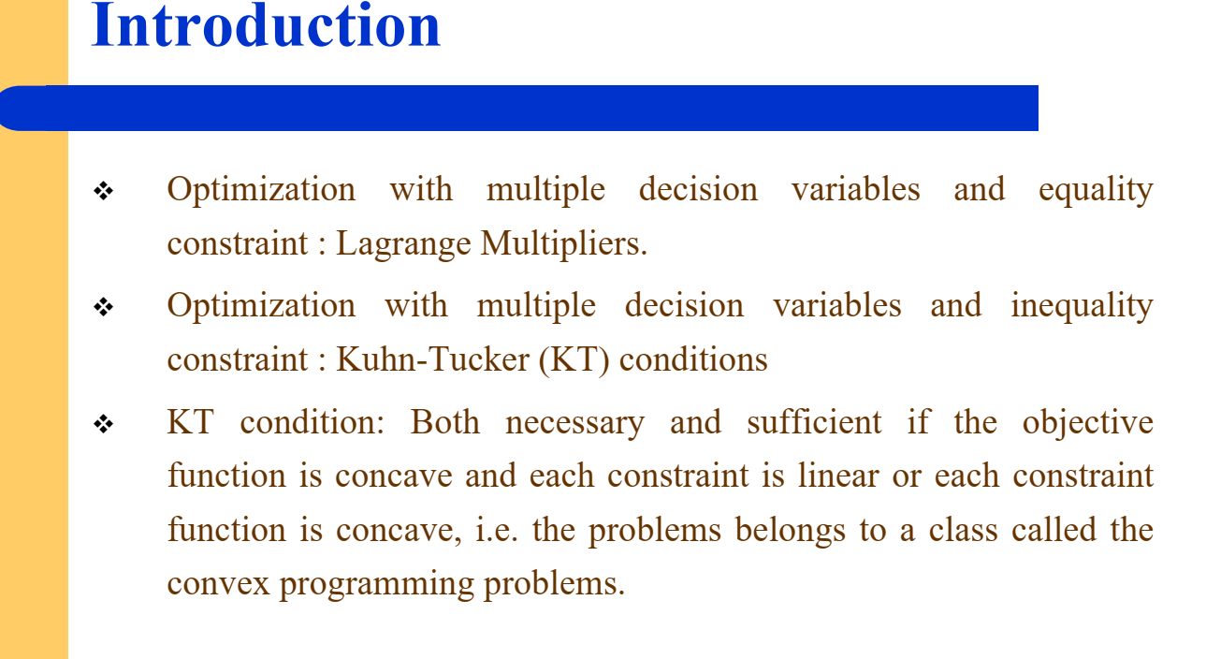

Slide 3
The optimality conditions for a constrained local optimum are called the Karush Kuhn Tucker (KKT) conditions.
They play an important role in constrained optimization theory and algorithm development.
The KKT conditions for optimality are a set of necessary conditions for a solution to be optimal in a mathematical optimization problem.
They are necessary and sufficient conditions for a local minimum in nonlinear programming problems.

Slide 4
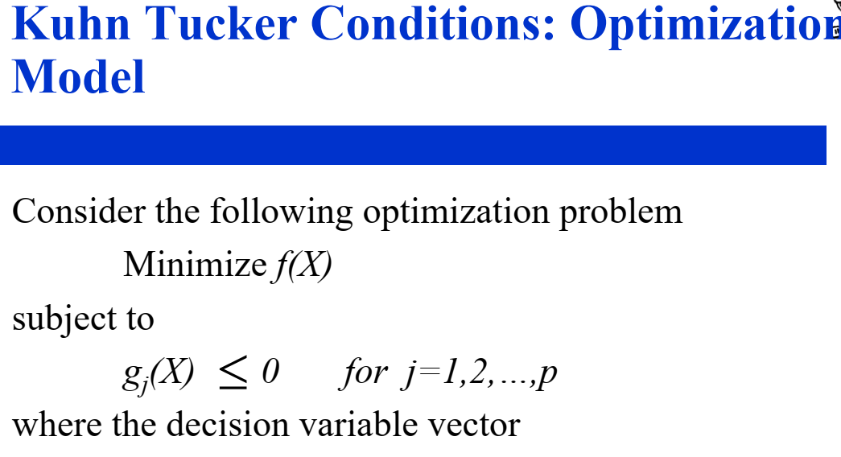

Slide 5
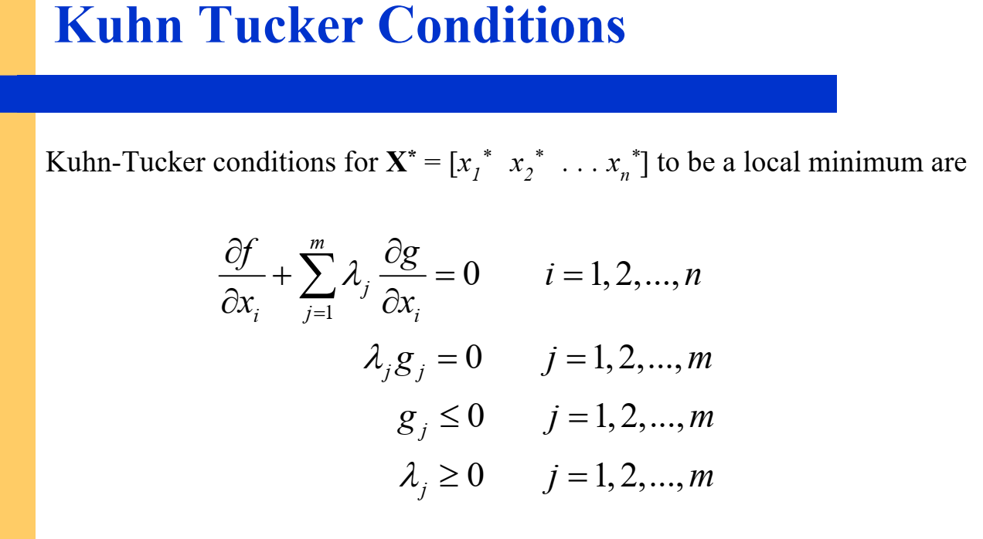
No Feasible Descent: No possible objective improvement at the solution
Complementarity: The product of the Lagrange multipliers and the corresponding variables must be zero.
Primal Feasibility: All constraints must be satisfied.
Dual Feasibility: The Lagrange multipliers associated with constraints have to be non-negative (zero or positive).

Slide 6
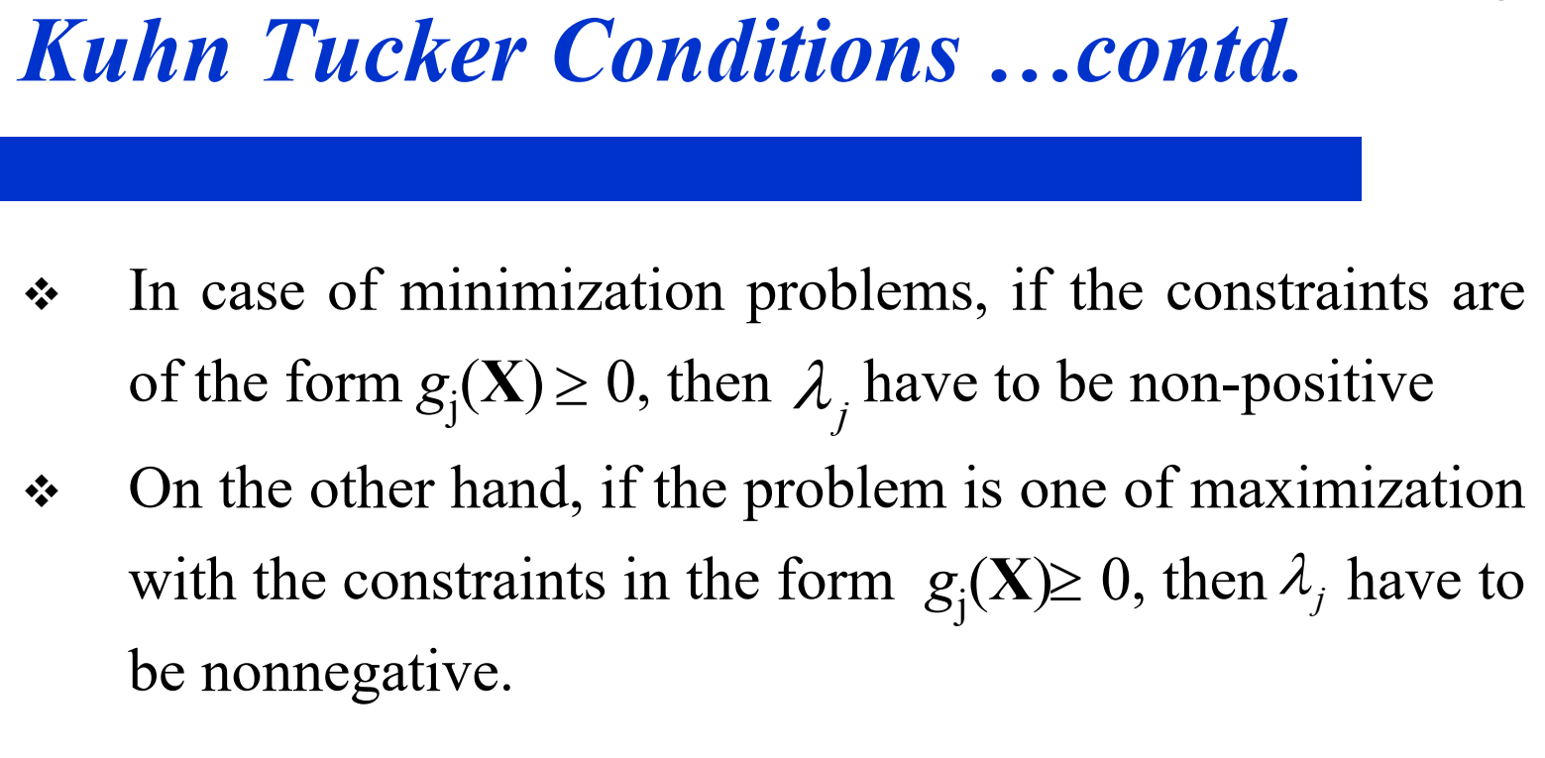

Slide 7
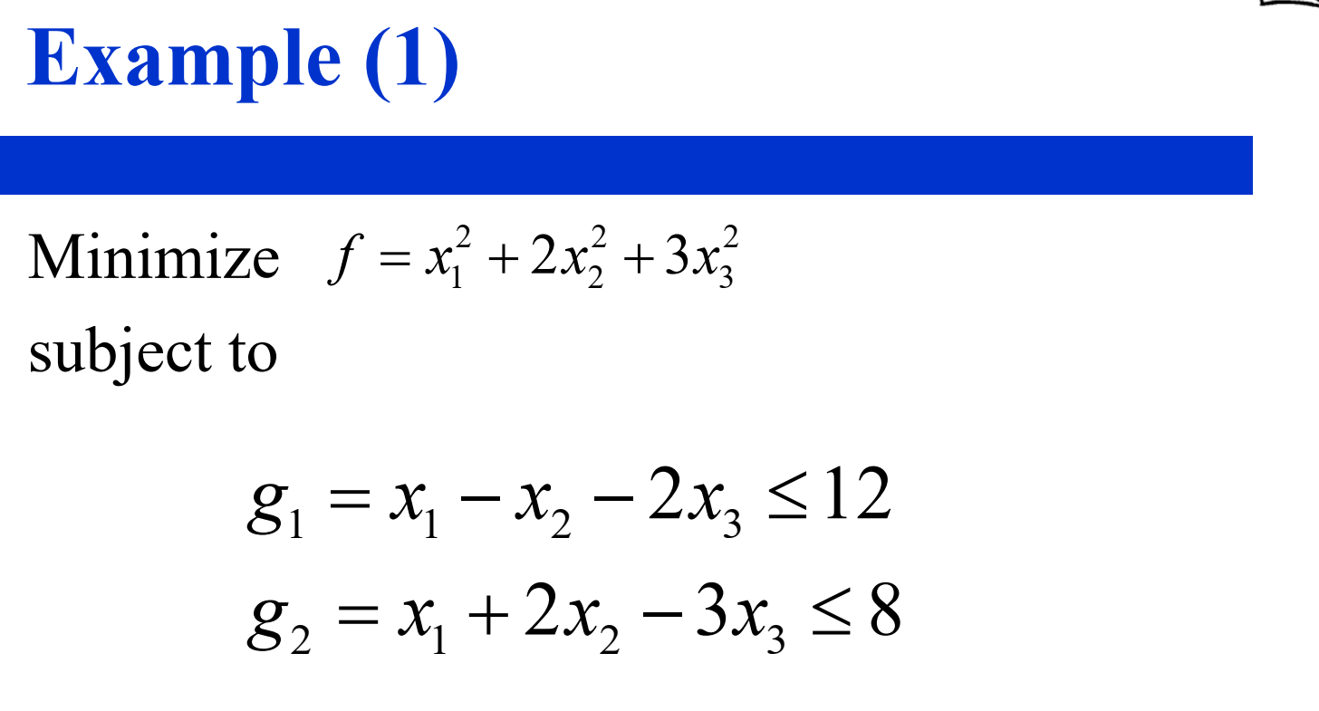

Slide 8
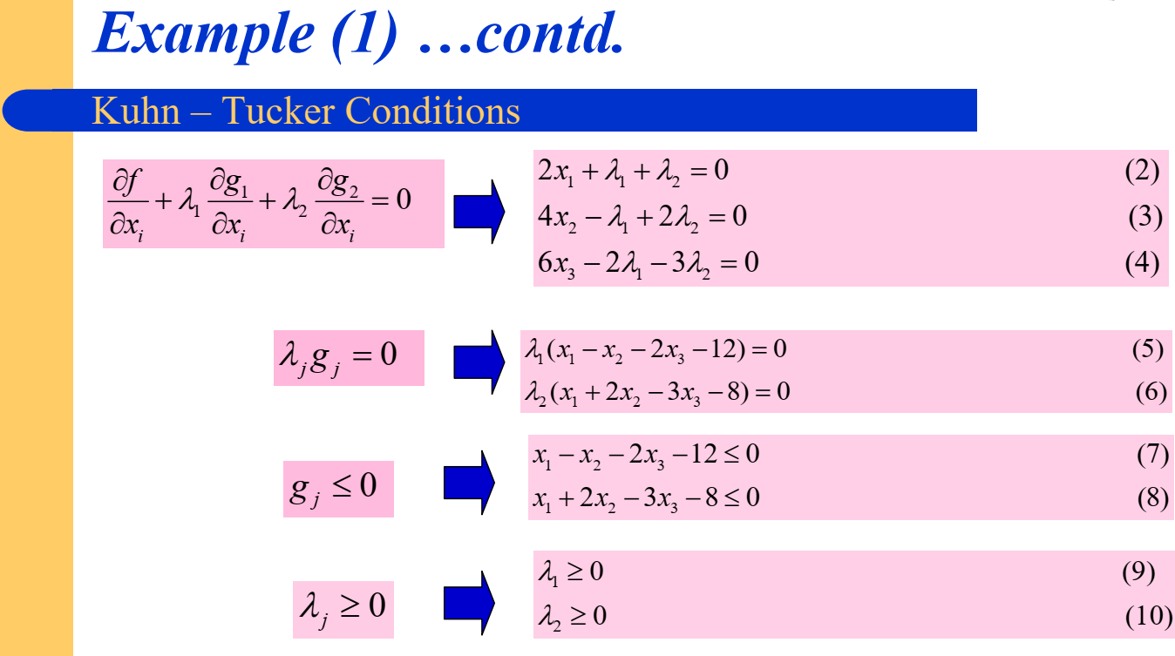

Slide 9
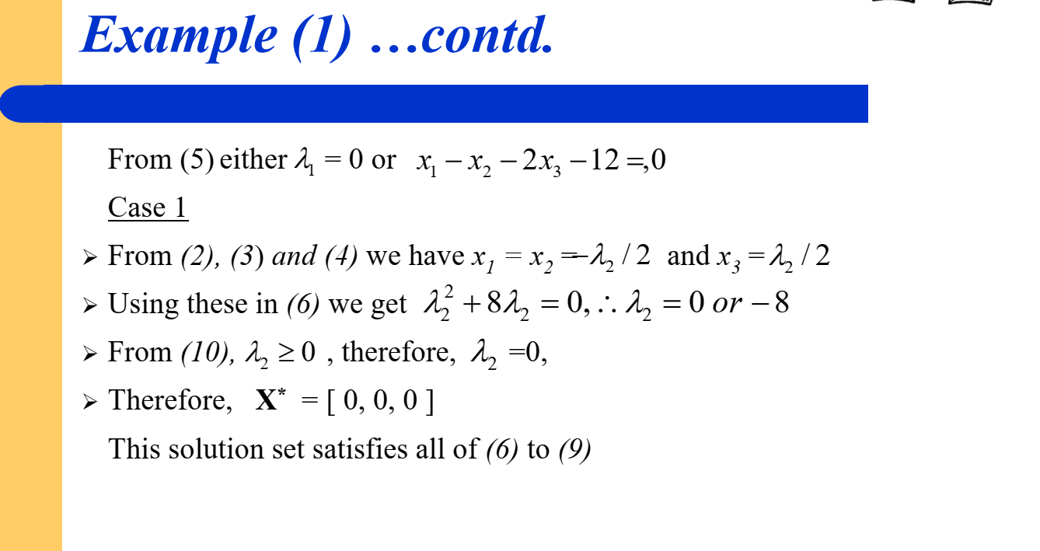

Slide 10
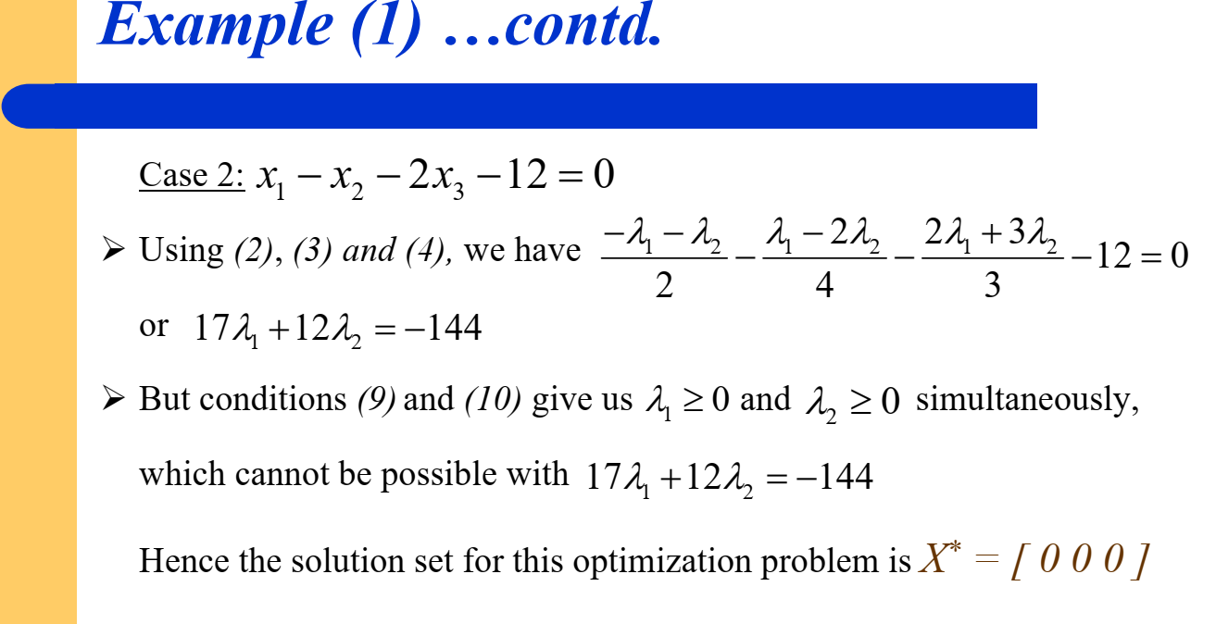

Slide 11
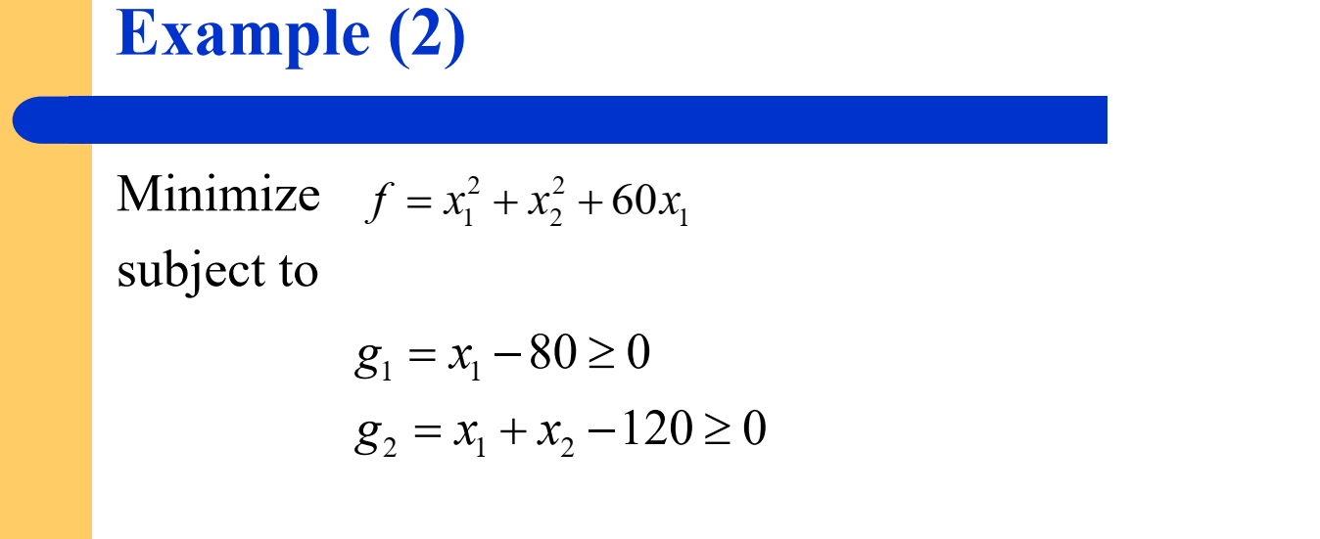

Slide 12
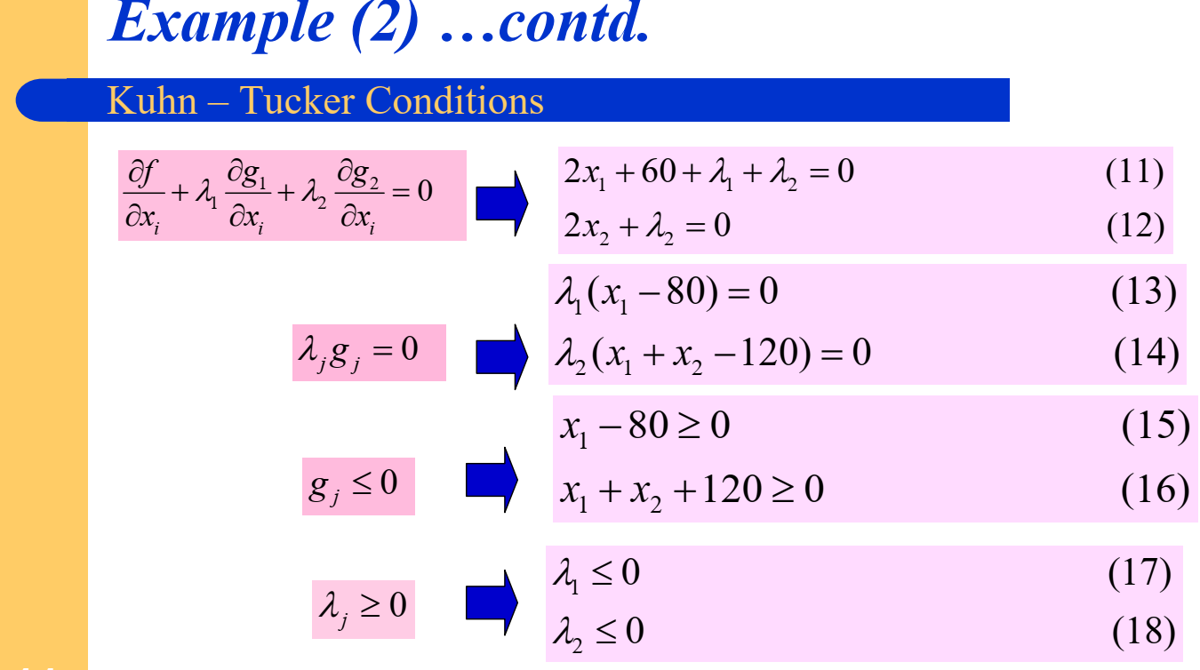

Slide 13
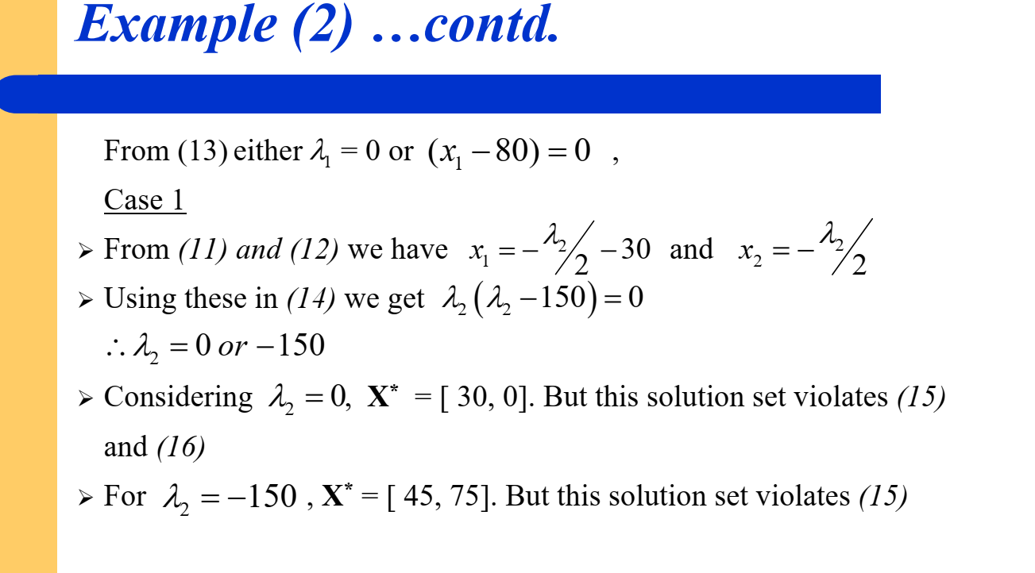

Slide 14
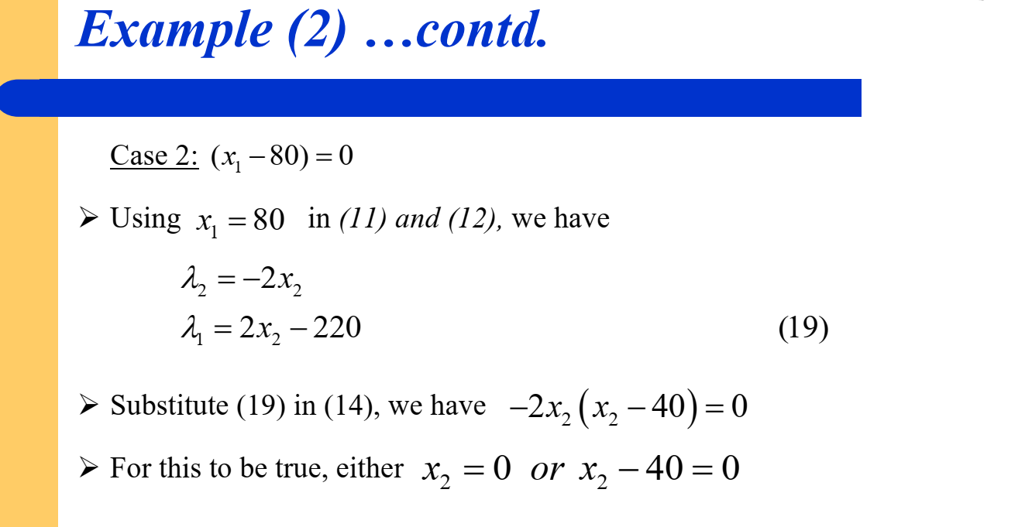

Slide 15
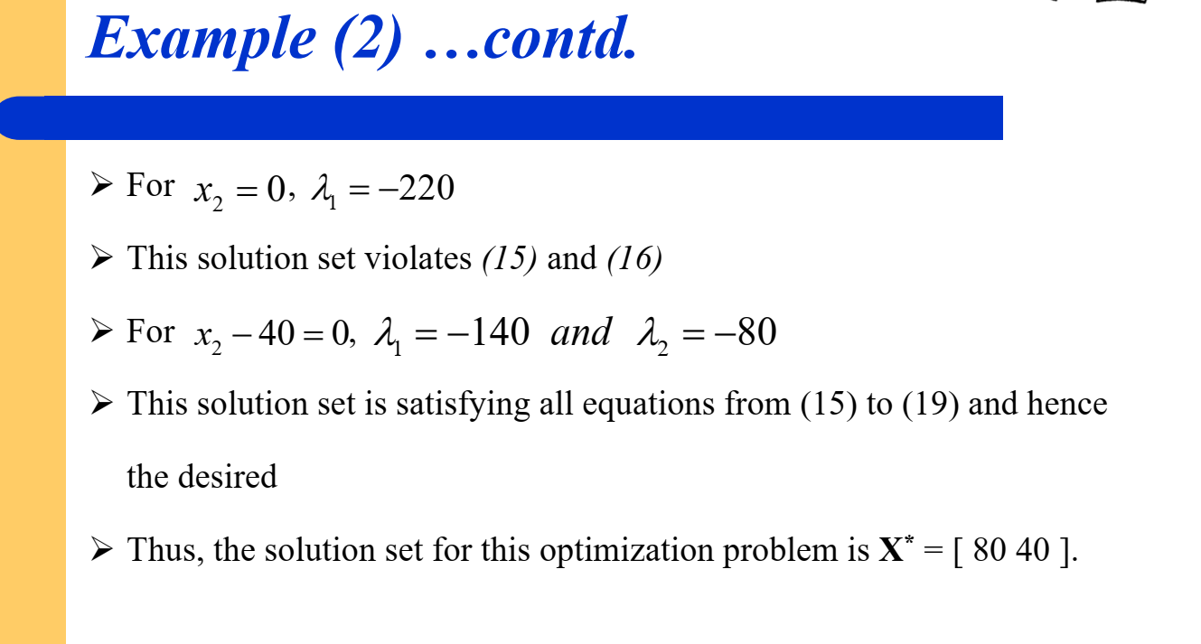

Slide 16
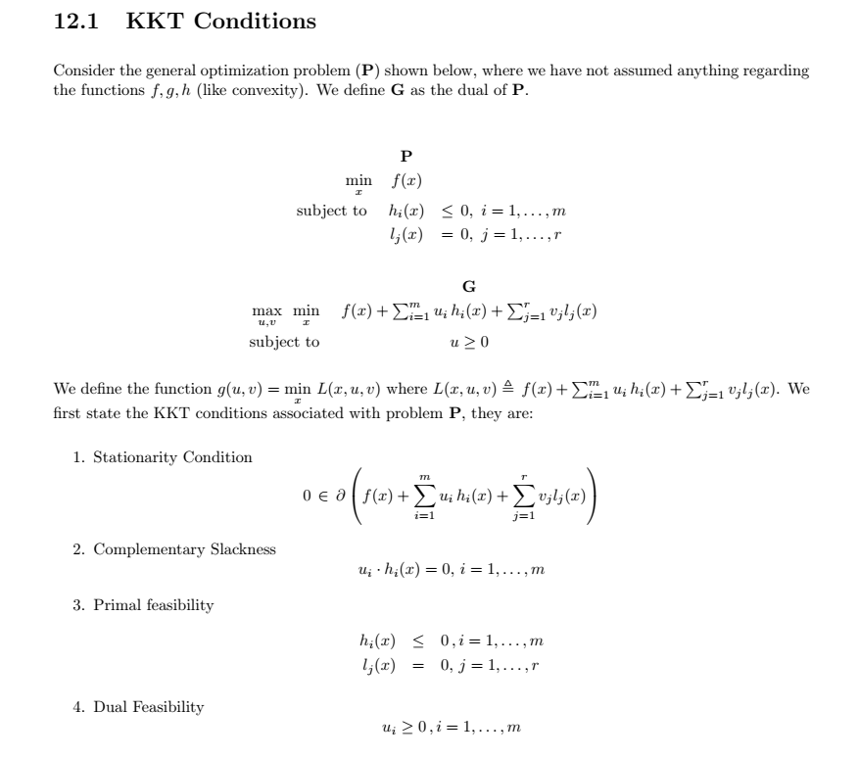

Slide 17
Thank You

